Slide 1

MSc Applied Computational Science and Engineering Independent Research Project
Generation of time-series sensory data
Name:
CID:
Supervisors:
Hameed Khandahari
01069638
Dr H. Haddadi
Dr G. Gorman

Slide 2

Aims and Motivation
Development of a generative model, capable of producing data resembling time-series sensory data.
Refining this model such that the output is indistinguishable from the data used to train the model.
Brave Logo (brave.com)

Slide 3
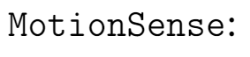
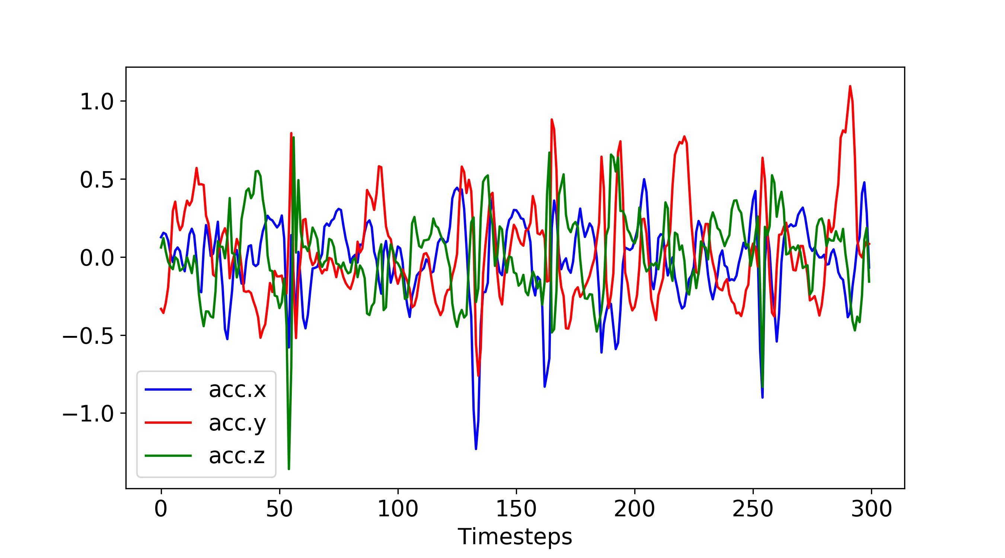
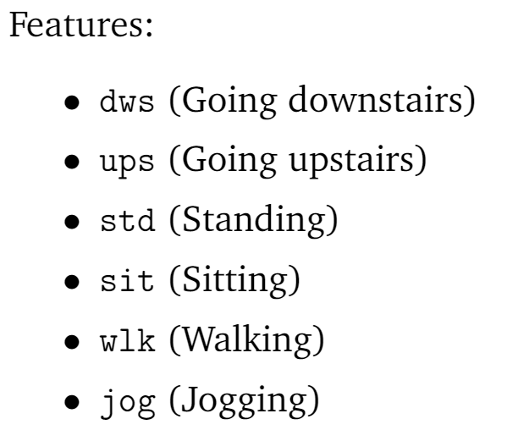
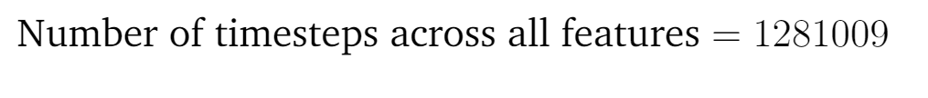

Dataset
Figure 2: Sample of dataset

Slide 4
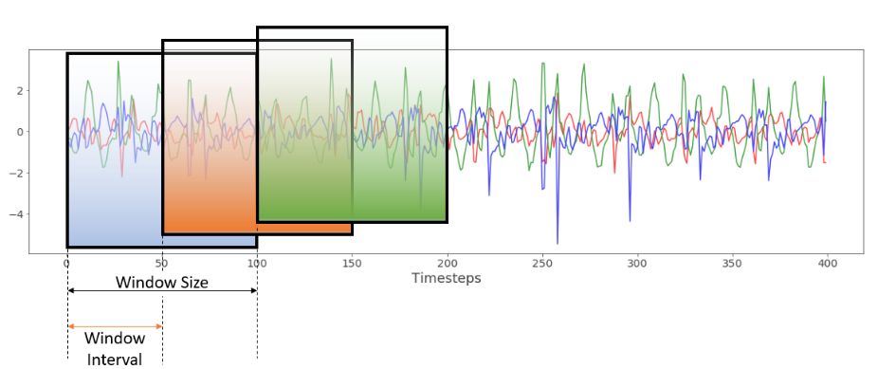
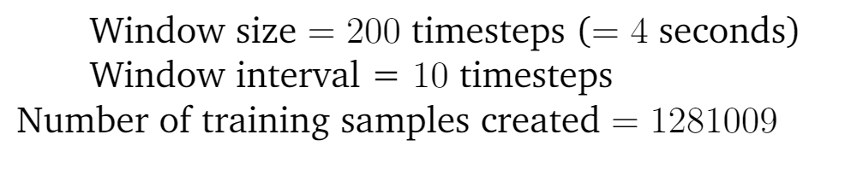
Data Preparation

Slide 5
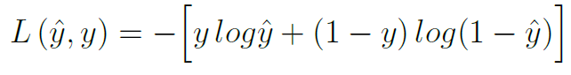
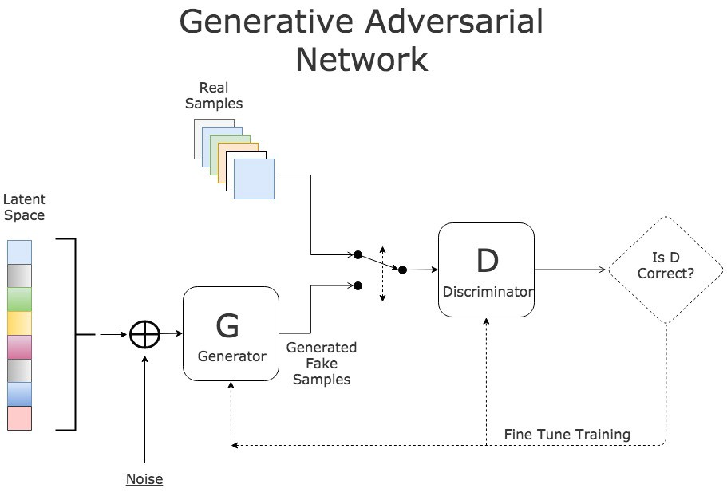
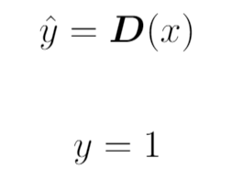
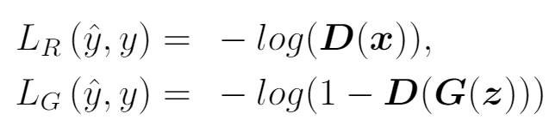
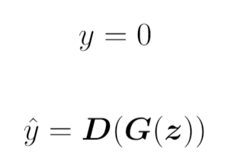
Generative Adversarial Networks (GANs)
Training the Discriminator
GAN Diagram: https://www.kdnuggets.com/2017/01/generative-adversarial-networks-hot-topic-machine-learning.html

Slide 6
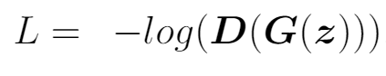
Generative Adversarial Networks (GANs)
Training the Generator
GAN Diagram: https://www.kdnuggets.com/2017/01/generative-adversarial-networks-hot-topic-machine-learning.html

Slide 7
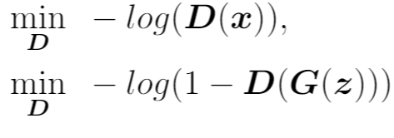
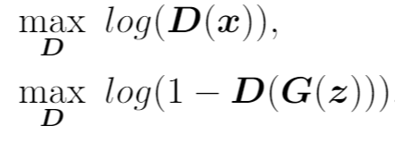
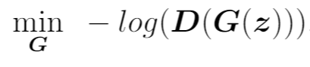
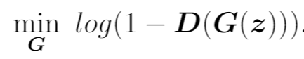
Generative Adversarial Networks (GANs)
Training the Discriminator
Training the Generator

Slide 8
Generative Adversarial Networks (GANs)
Training the Discriminator
Training the Generator

Slide 9
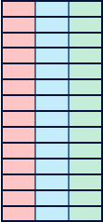
Designing the Neural Networks
Discriminator
f₁
f₂
f₃
Timesteps
Dense
ReLu Activation
Convolution
ReLu Activation
Dense
Sigmoid Activation
Convolution
ReLu Activation
Training data sample
Convolutional feature map
Flattening to 1 dimension
Further one dimensional convolution
Score

Slide 10
Designing the Neural Networks
Generator
Dense
BatchNorm
LeakyReLu
Reshape
UpSampling
Convolution
LeakyReLu
UpSampling
Convolution
tanh
Latent Space Vector
Upsampled
convolutional
layer
Dense
Layer
Reshaped
Layer
Generated
data
sample

Slide 11
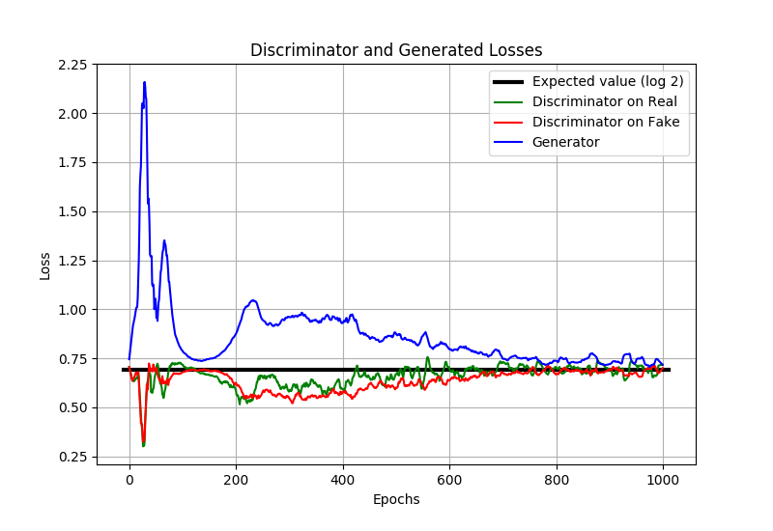
Training Process
Optimisers
Discriminator:
Stochastic Gradient Descent (SGD)
Learning rate = 0.012
Generator:
Adam
Learning rate= 0.0002
Beta1 = 0.9
Beta2 = 0.999
2000 4000 6000 8000 10000
Epochs

Slide 12
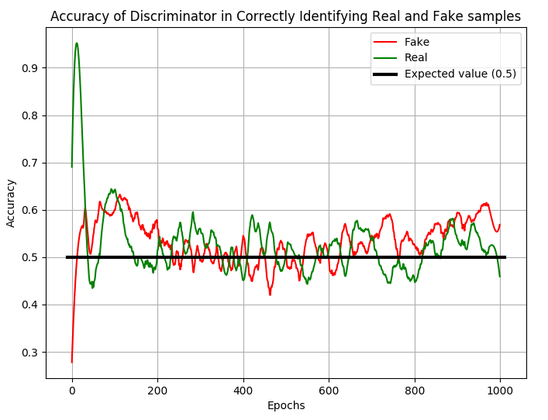
Training Process
Other hyperparameters
Batch Size:
128
Training epochs:
10,000
Feature scaling:
-1 to 1 normalisation
2000 4000 6000 8000 10000

Slide 13
Problems
Mode Collapse
Non convergence
Convergence to ‘wrong’ output
Solutions:
Changing structure of neural network from dense to deep convolutional
Changing the discriminator optimiser from Adam to SGD
Fine-tuning hyperparameters

Slide 14
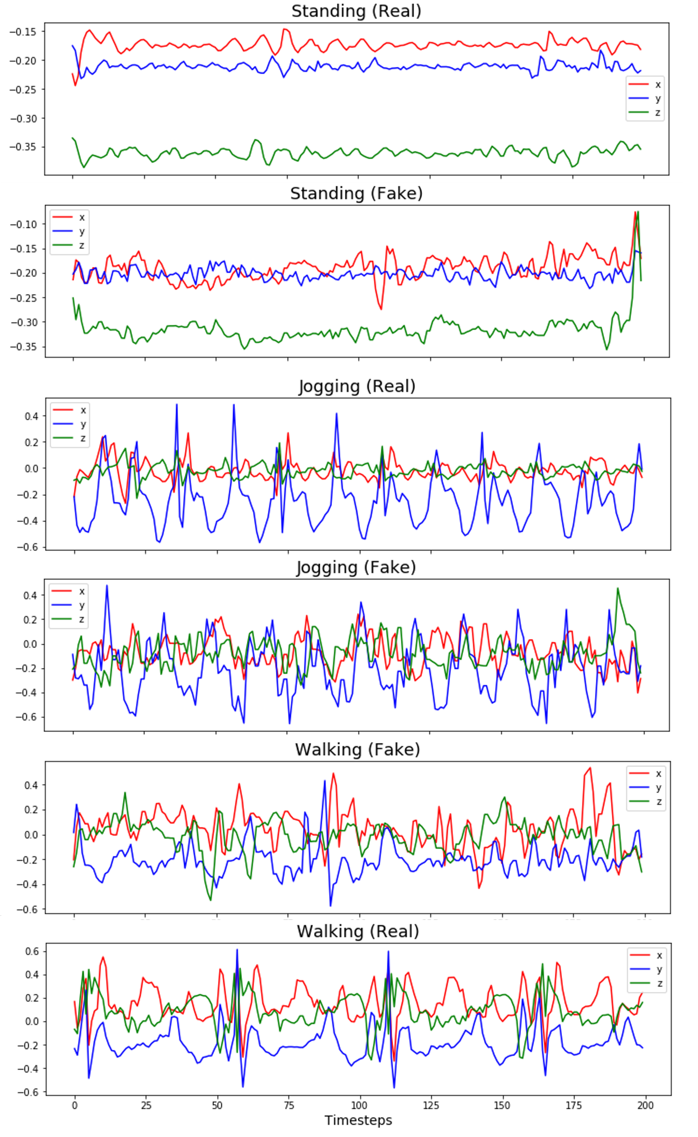

Results

Slide 15

Results

Slide 16
Results

Slide 17
Further work
Long Short Term Memory (LSTM implementation)
Wasserstein GAN for improved training
Modifying generator loss function to include pre-trained classifier

Slide 18
Acknowledgments
Dr H. Haddadi
Dr M. Malekzadeh
Dr G. Gorman
Dr O. Dubrule
Dr L. Mosser
Ms A. Villanova

Slide 19
THANK YOU FOR YOUR ATTENTION

